Slide 1
Finite Automata

Slide 2
Outline
Representing Automatic door as FA
Formal Definition of FA
Description of FA
Examples of FA

Slide 3
Finite Automata (FA)
Finite Automata are good models for computers with an extremely limited amount of memory.
Examples include : Automatic doors, vending machines, elevators

Slide 4
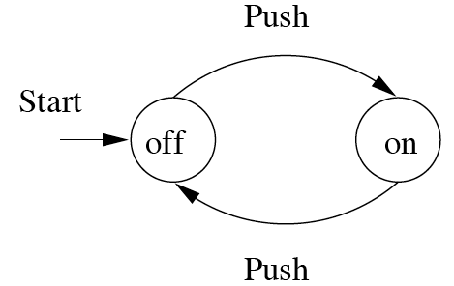
Finite Automata : Examples
On/Off switch
action
state

Slide 5
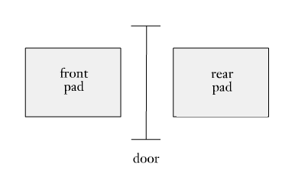
Automatic Door
The automatic door at any grocery store has two pads:
One in front of the door.
One behind the door.
The door is in one of two possible states:
Open
Closed

Slide 6
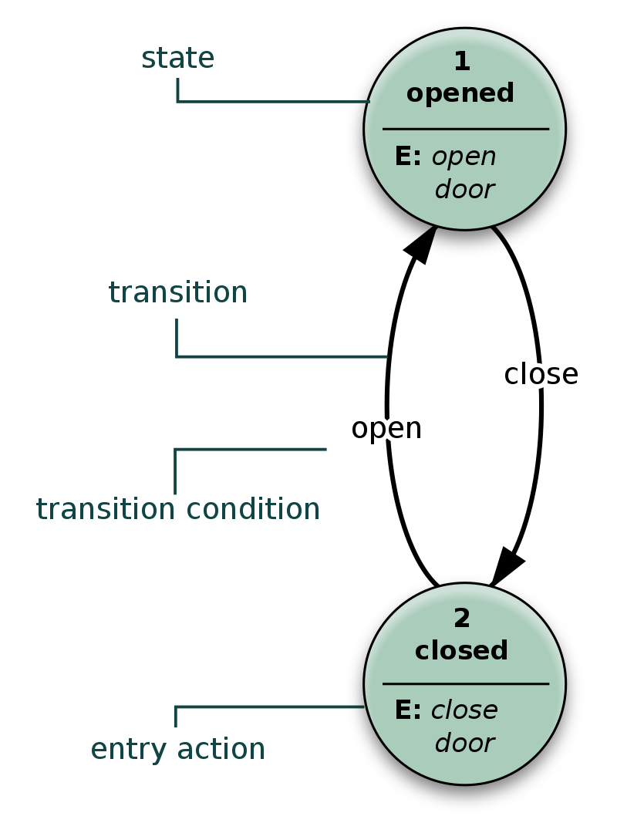
Automatic Door Example
A state diagram is a type of diagram used in computer science to describe the behavior of systems.
State diagrams require that the system described is composed of a finite number of states.
Transitions are actions you perform to move between states.

Slide 7
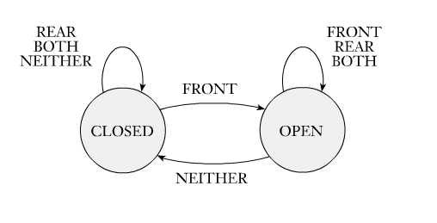
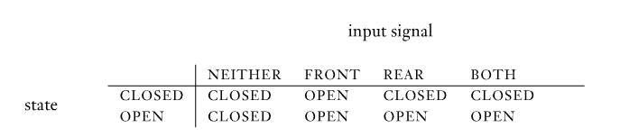
State Diagram & State Table

Slide 8
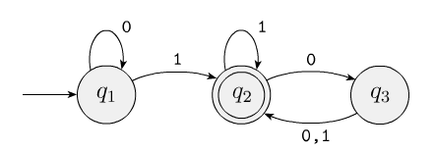
Example
Informally, a state diagram that comprehensively captures all possible states and transitions that a machine can take while responding to a sequence of input symbols

Slide 9
Finite Automata - Definition
A Finite Automaton (M) consists of:
Q ==> a finite set of states
∑ ==> a finite set of input symbols (alphabet)
q₀ ==> a start state
F ==> set of accepting states
δ ==> a transition function, which is a mapping between Q x ∑ ==> Q
An automaton is defined by the 5-tuple:
M= {Q, ∑ , q₀,F, δ }

Slide 10


Cont…
$M_{1}$ = (Q, Ʃ, δ, S, F)
Q = {q₁, q₂, q₃}
Ʃ = {0, 1}
S = q₁
F = {q₂}
δ= {(q₁, 0, q₁), (q₁, 1, q₂),
(q₂, 1, q₂), (q₂, 0, q₃),
(q₃, 0, q₂), (q₃, 1, q₂)}
Accepted strings: 1, 01, 011, 100
Rejected Strings: 010, 11010

Slide 11
Alphabet
An alphabet is a finite, non-empty set of symbols
We use the symbol ∑ (sigma) to denote an alphabet
Examples:
Binary: ∑ = {0,1}
All lower case letters: ∑ = {a,b,c,..z}
Alphanumeric: ∑ = {a-z, A-Z, 0-9}

Slide 12
Strings
A string or word is a finite sequence of symbols chosen from ∑
Empty string is ε (or “epsilon”)
Length of a string w, denoted by “|w|”, is equal to the number of (non- ε) characters in the string
E.g., x = 010100 |x| = 6
y = 01 ε 0 ε 1 ε 00 ε |x| = ?
w=ab
xw = concatentation of two strings x and w

Slide 13
Kleene Star
Definition − The Kleene star, ∑*, is a unary operator on a set of symbols or strings, ∑ , that gives the infinite set of all possible strings of all possible lengths over ∑ including ɛ.
Representation − ∑* = ∑₀ ∪ ∑₁ ∪ ∑₂ ∪……. where ∑_{p} is the set of all possible strings of length p.
Example − If ∑ = {a, b}, ∑* = {ɛ, a, b, aa, ab, ba, bb,………..}

Slide 14
Kleene Closure
Definition − The set ∑⁺ is the infinite set of all possible strings of all possible lengths over ∑ excluding ɛ.
Representation − ∑⁺ = ∑₁ ∪ ∑₂ ∪ ∑₃ ∪…….
∑⁺ = ∑* − { ɛ }
Example − If ∑ = { a, b } , ∑⁺ = { a, b, aa, ab, ba, bb,………..}

Slide 15
Languages
L is a said to be a language over alphabet ∑, only if L ⊆ ∑*
➔ this is because ∑* is the set of all strings (of all possible length including 0) over the given alphabet ∑
Examples:
Let L be the language of all strings consisting of n 0’s followed by n 1’s:
L = {ε, 01, 0011, 000111,…}
Let L be the language of all strings of with equal number of 0’s and 1’s:
L = {ε, 01, 10, 0011, 1100, 0101, 1010, 1001,…}
Definition: Ø denotes the Empty language
Let L = {ε}; Is L=Ø? No

Slide 16
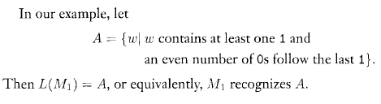

Language of Automata $M_{1}$

Slide 17
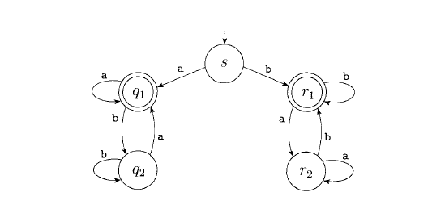
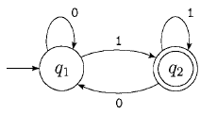
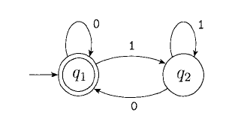
Examples

